Slide 1


Slide 2




Disclaimer
Don’t do illegal shit

Slide 3
What is a Hash
Hash is a function that converts data from one value to another, masks the original data with another.
Within computing hashes can be used for:
Compression
Checksum
Cryptography
Data Indexing
Passwords

Slide 4
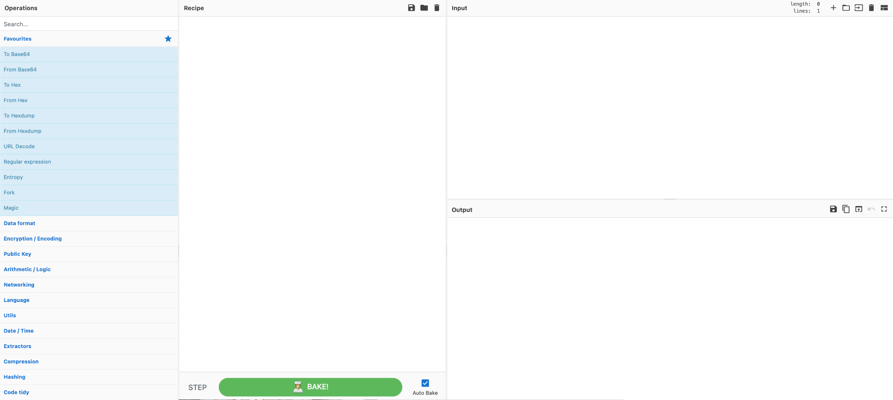
Making Our Own Hashes
Quick and easy - CyberChef
CyberChef is a website where you can give it some input, specify what you want to happen to the input and then get an output.
Putting “Hello World” into CyberChef with the MD5 recipe gives “b10a8db164e0754105b7a99be72e3fe5”

Slide 5
Cracking Hashes
Tools:
CyberChef
Name That Hash
Hashcat
John The Ripper

Slide 6

Hashcat
Hashcat is a password recovery tool. It had a proprietary code base until 2015, but was then released as open source software.
It is an extremely powerful tool that comes with a learning curve.

Slide 7

John The Ripper
John the Ripper is an Open Source password security auditing and password recovery tool available for many operating systems.

Slide 8
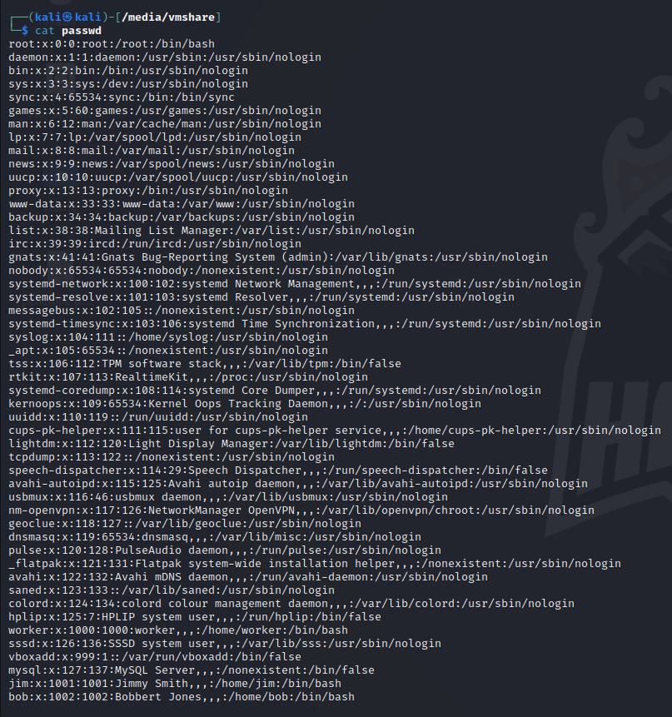
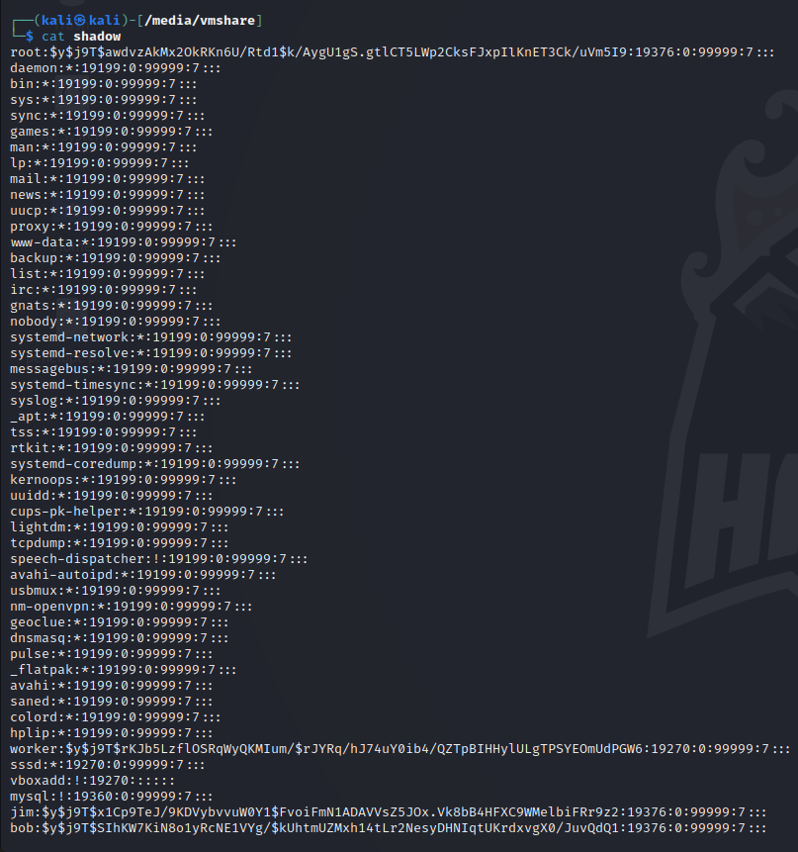
Passwd and Shadow

Slide 9
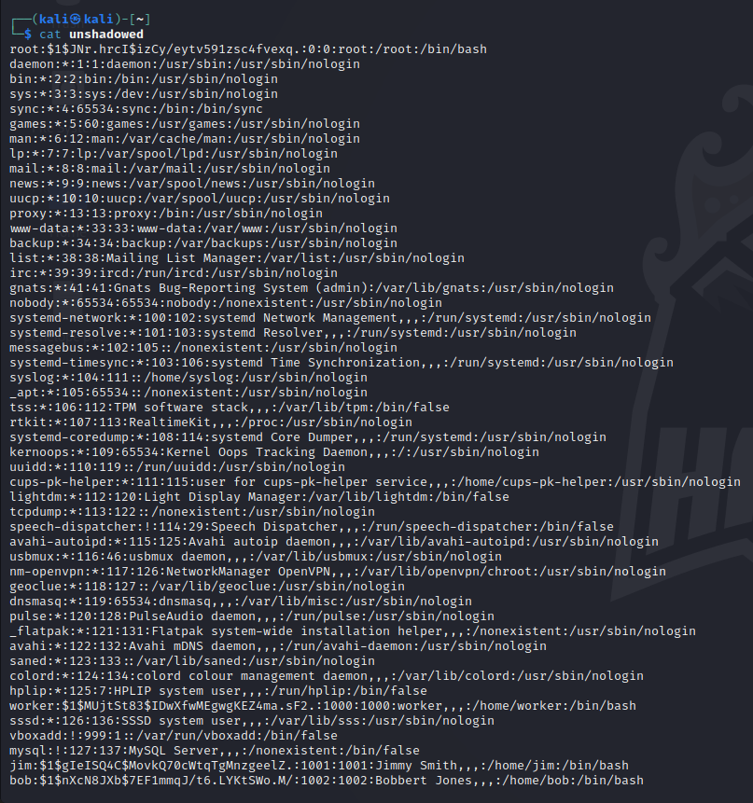
Passwd and Shadow

Slide 10
Practical
Hashes:
71dcf159a578367d77f57f3a9c90cd5d
764929ee45b4afff229ed32a53525a00
9e5003e079cddcaf84a8cfe7cf31fa1b
2f1a88bbe1c6b12a41b8325492142962
df52555a6896eef0a71a8a0a80226d19
3de02ef6cc3991e37c3637e863e5f7b9dec1b8126a14de275b96c5f732cbe3b5fa258b96d1fcdaac10ed5c02743cc4246c2aee37f1b7a992fa6d325846299f27
60499c8407a3e02a372a864f3a2602610d83da52eea4812f0f6b62e4e2a09fdbceec67e76cd70218d9086612e031fffe8ad62448b0e13aaebb7d8b89d05f3af7
20153471c7fc6a0c5c67e30771d0572d15ab10c8351c4718e41f835aa9a1fb7de311d540fe24ae15f7a80ed7ce950831704e49f3296cb466e0b059ba45d0e195

Slide 11
Practical
Jordon’s Pratical:
Decrypt Shadow files
TryHackMe:
Crack The Hash (https://tryhackme.com/room/crackthehash)
Crack The Hash Level 2 (https://tryhackme.com/room/crackthehashlevel2)
John The Ripper (https://tryhackme.com/room/johntheripper0)
Brute It (https://tryhackme.com/room/bruteit)

